Slide 1
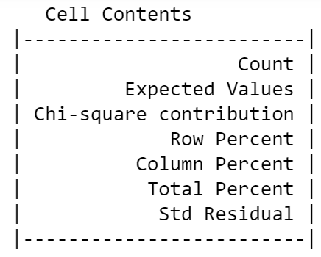
Part2. Analysis
QUESTION:
“Child – Adolescent – Adult Autism: What Change?”
Possible answers: Strongly agree, Slightly agree, Slightly disagree, Strongly disagree
Scoring system: 0 and 1, a point directs to "autism" behavior traits
Part1. Inspection of Pearson's Chi-squared test P-values identifies analysis is significant only in A1, A3, A6, A7, A8, A9

Slide 2
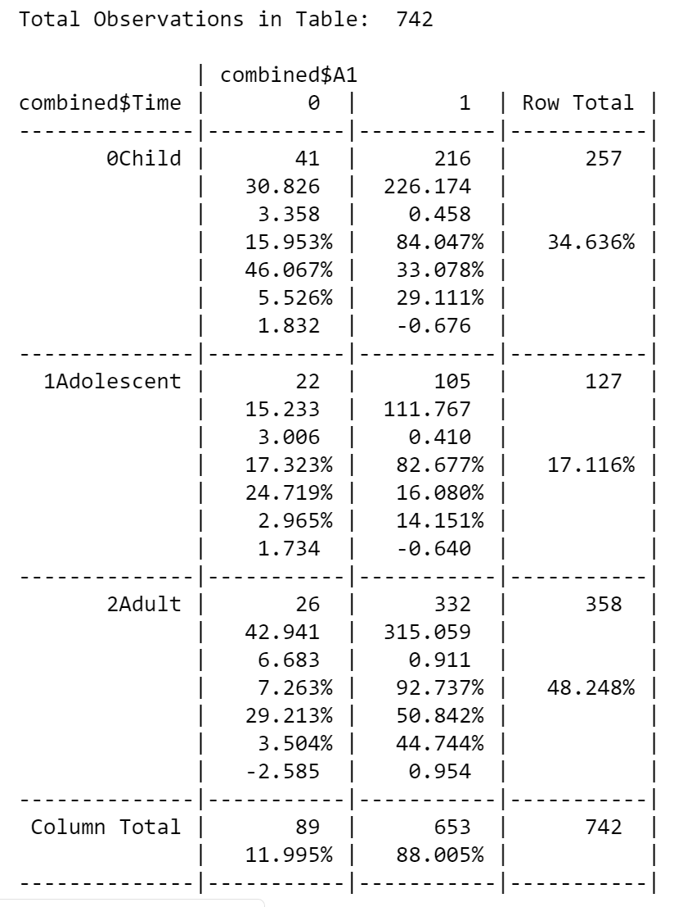
## A1: Attention to Detail (0 = Disagree, 1 = Agree)
### C S/he often notices small sounds when others do not
### AT S/he notices patterns in things all the time
### AD I often notice small sounds when others do not
Significant Analysis (Adult, 0 Std Residual: -2.585):
Fewer Adults than expected, do not notice small sounds like others
Answer to Q: Adults have significant tendency to lose
attention to details

Slide 3
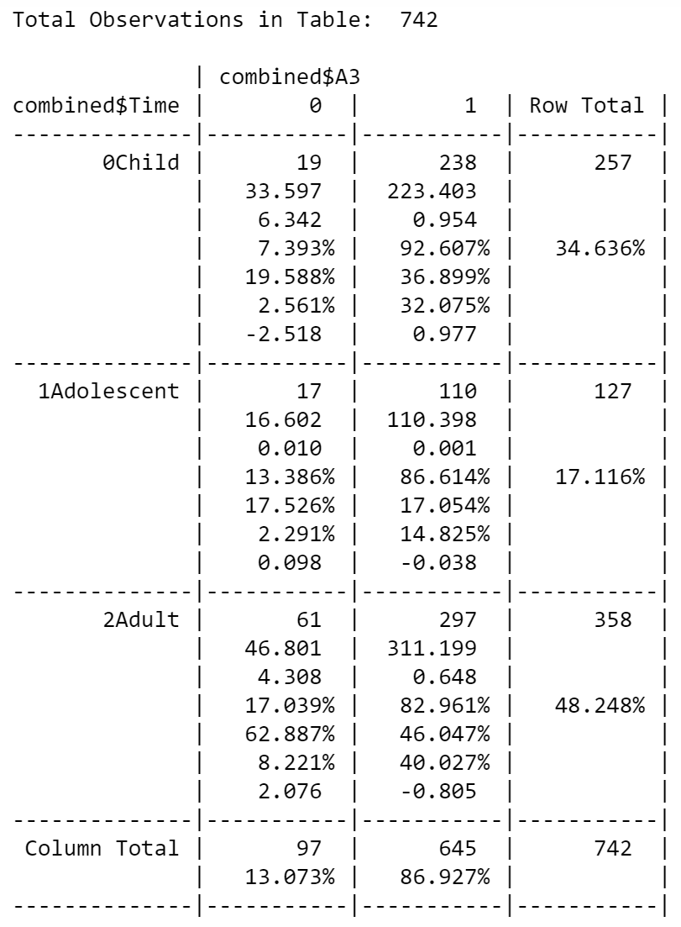
## A3: Attention Switching (0 = Agree, 1 =Disagree)
### C In a social group, s/he can easily keep track of several different people’s conversations
### AT In a social group, s/he can easily keep track of several different people’s conversations
### AD I find it easy to do more than one thing at once
Significant Analysis (Child, 0 Std Residual: -2.518)
Fewer Children than expected, acknowledge to keep track of several different people's conversations
Significant Analysis (Child, 0 Std Residual: 2.076)
More adults than expected, acknowledge to keep track of several different people's conversations
Answer to Q: Adults are significantly better
at attention switching

Slide 4
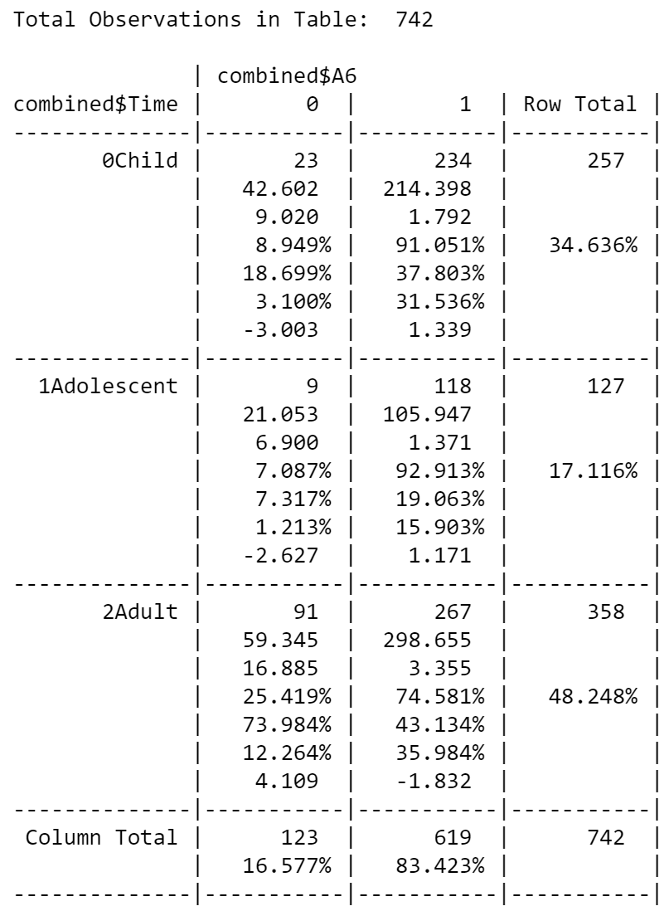
## A6: Communication (0 = Agree, 1 =Disagree)
### C S/he is good at social chit-chat
### AT S/he is good at social chit-chat
### AD I know how to tell if someone listening to me is getting bored
Significant Analysis (Child, 0 Std Residual: -3.003)
Less children than expected, acknowledge to be good at social chit-chat
Significant Analysis (Adolescents, 0 Std Residual: -2.627)
Less adolescents than expected, acknowledge to be good at social chit-chat
Significant Analysis (Adult, 0 Std Residual: 4.109)
More adults than expected, acknowledge to know how to tell if someone listening is getting bored
Answer to Q: Adults have significant
ability to communicate

Slide 5
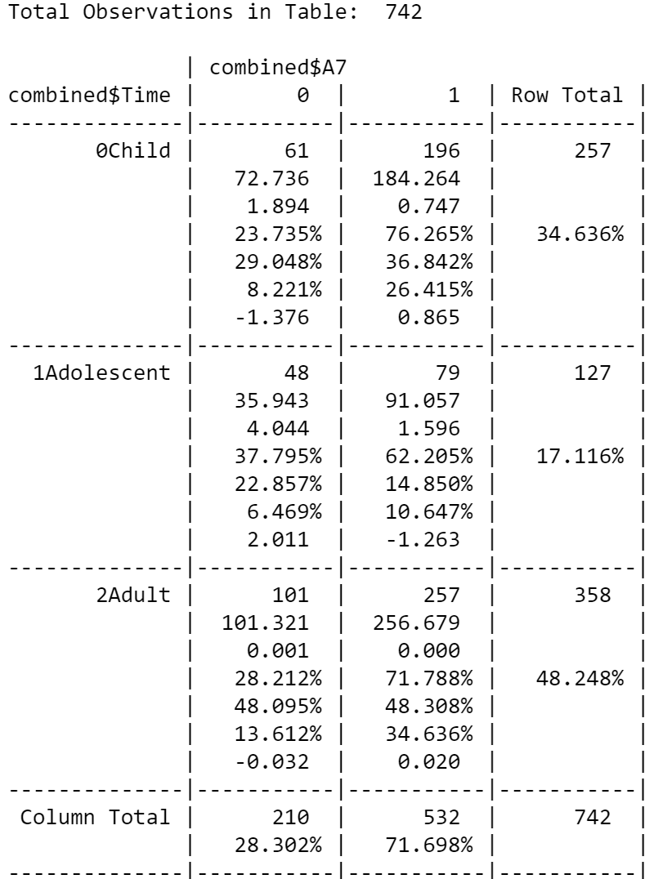
## A7: Imagination (0 = Disagree, 1 = Agree)
### C When s/he is read a story, she finds it difficult to work out the character’s intentions or feelings
### AT When s/he was younger, s/he used to enjoy playing games involving pretending with other children
### AD When I’m reading a story, I find it difficult to work out the character’s intentions
Significant Analysis (Adolescent, 0 Std Residual: 2.011)
More Adolescents than expected, do not acknowledge that when they were younger, they enjoy playing games
involving pretending with other children
Answer to Q: Imagination significantly declines at adolescence

Slide 6
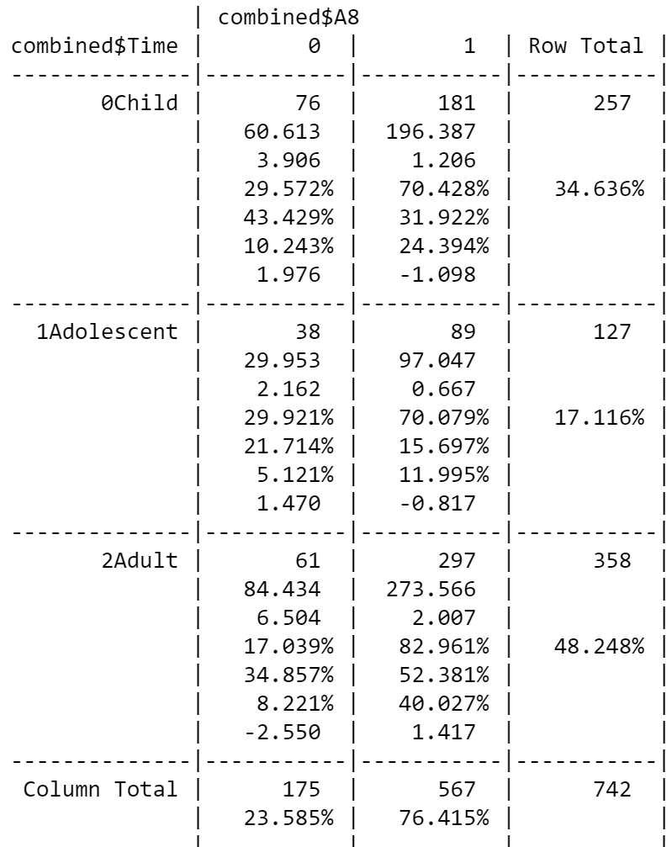
## A8: Imagination (0 = Disagree, 1 = Agree)
### C When s/he was in preschool, she used to enjoy playing games involving pretending with other children
### AT S/he finds it difficult to imagine what it would be like to be someone else
### AD I like to collect information about categories of things (e.q. types of car, types of bird, types of train etc)
Significant Analysis (Adult, 0 Std Residual: -2.550)
Fewer adults than expected, do not acknowledge to like collecting information about categories of things
Answer to Q: Imagination significantly declines at adulthood
Note: A7 is also on Imagination;
May conclude imagination significantly declines with age?

Slide 7
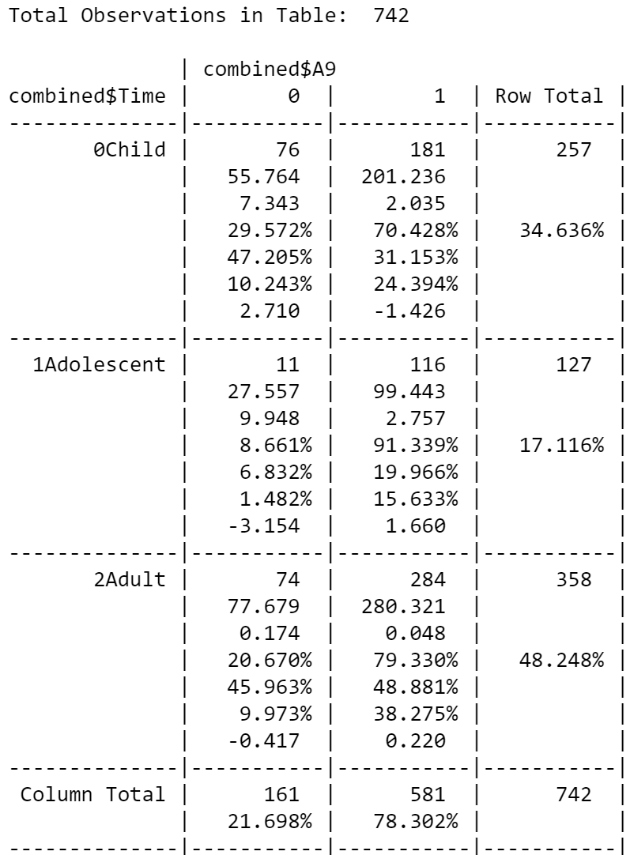
## A9: Social (0 = Agree, 1 = Disagree)
### C S/he finds it easy to work out what someone is thinking or feeling just by looking at their face
### AT S/he finds social situations easy
### AD I find it easy to work out what someone is thinking or feeling just by looking at their face
Significant Analysis (Child, 0 Std Residual: 2.710)
More children than expected, find it easy to work out what someone is thinking or feeling just by looking at their face
Significant Analysis (Adolescent, 0 Std Residual: -3.154)
Less adolescents than expected, find social situations easy
Answer to Q: Children are significantly aware socially and there's a significant decrease on this awareness going into the
adolescence stage

